Slide 1
Machine Learning Data Insights and Visualizations
Project: ChurnModel
Last export: 8/19/2024 7:15 PM

Slide 2
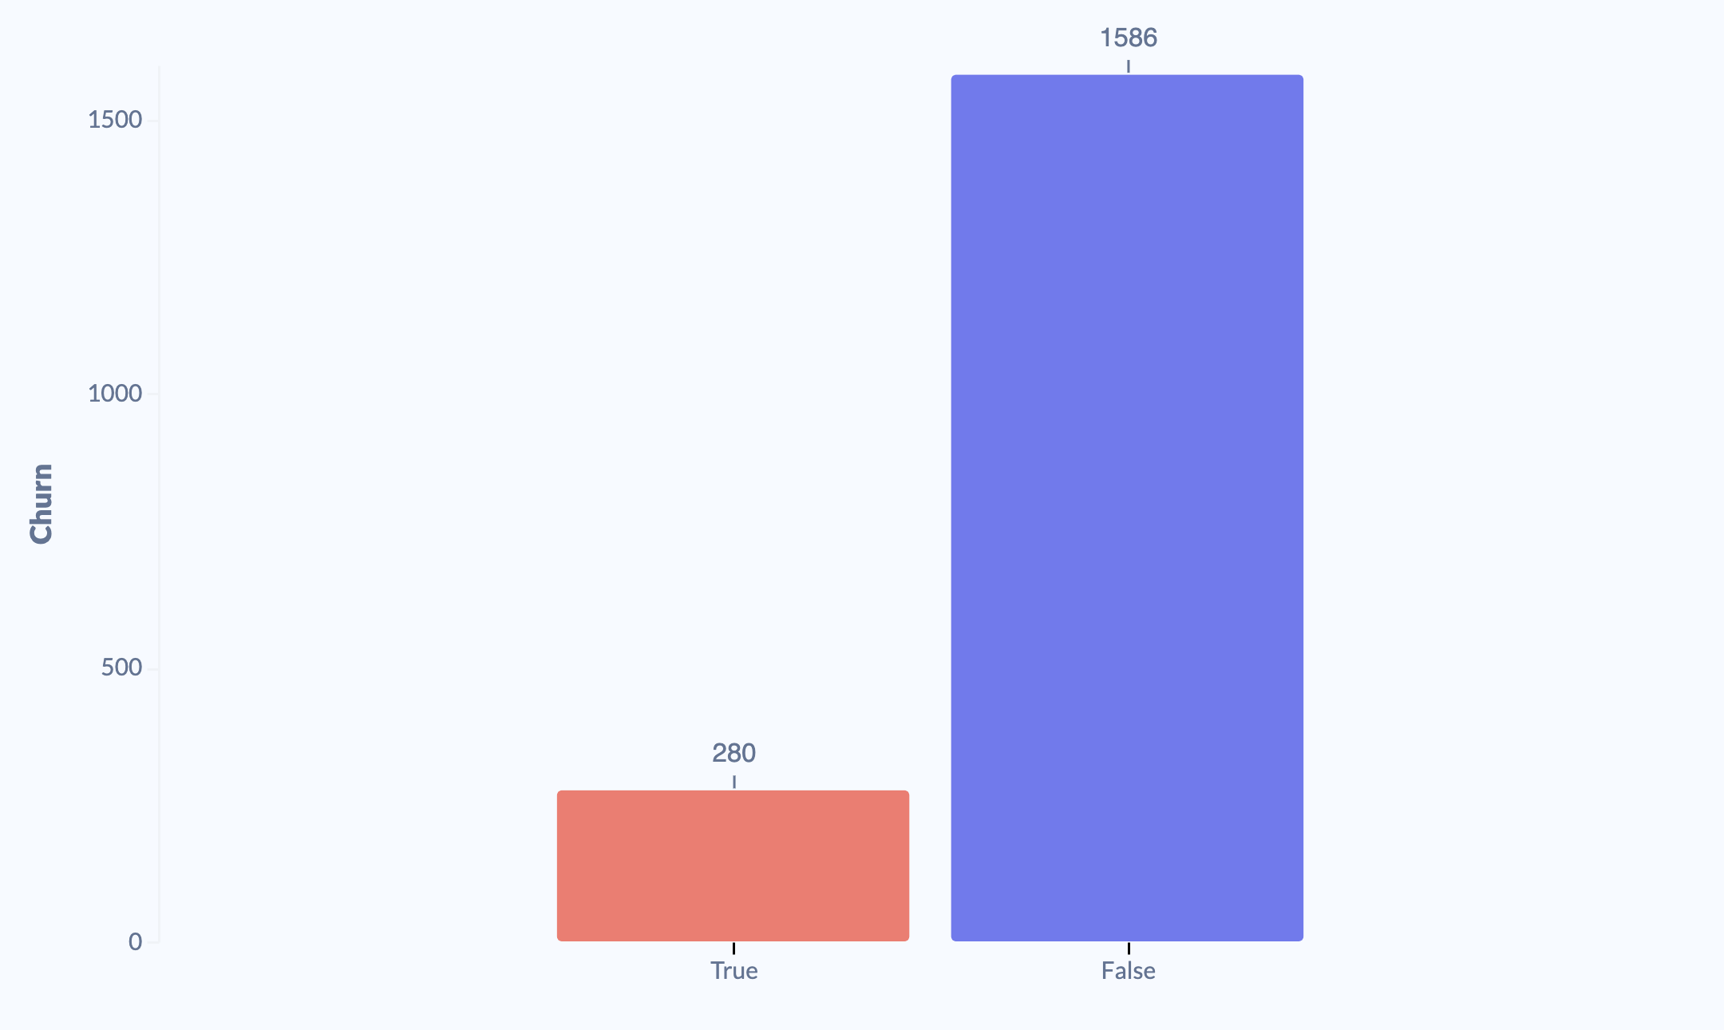
Data Insights: Target
Target Variable Details: Churn
This histogram shows the distribution of the data in your target.

Slide 3
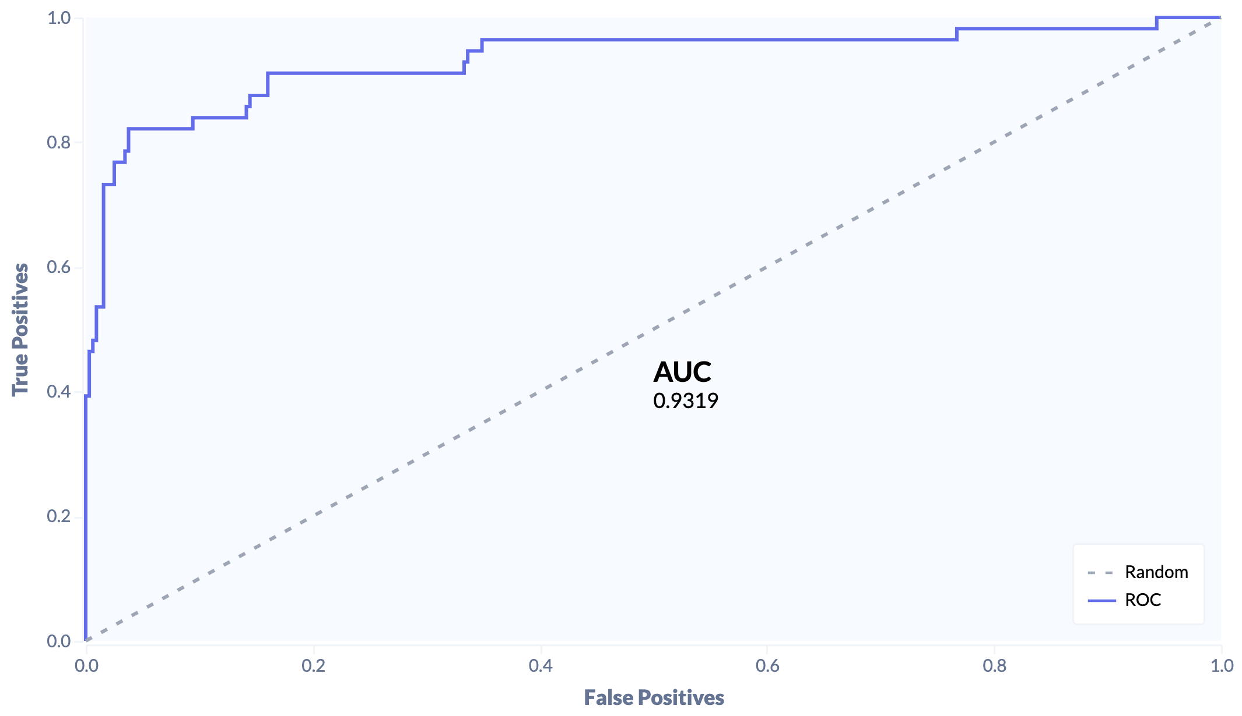
Evaluate Model: Performance
ROC Curve
The ROC curve plots the performance of your model. The better your model identifies True Positives and rejects False Positives, the more the line curves toward the upper-left corner.

Slide 4
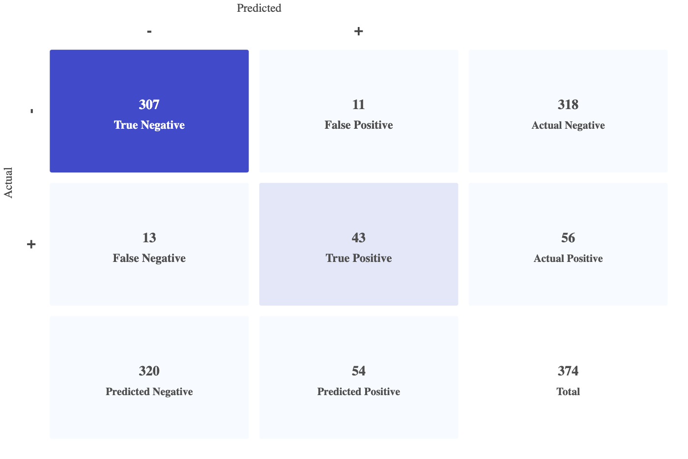
Evaluate Model: Performance: Metrics
Confusion Matrix
The Confusion Matrix shows how well your model makes correct predictions. The matrix splits the prediction cases into 4 or more quadrants. True Positives and True Negatives indicate when your model agrees with the actual values. False Positives and False Negatives count your model's errors.

Slide 5
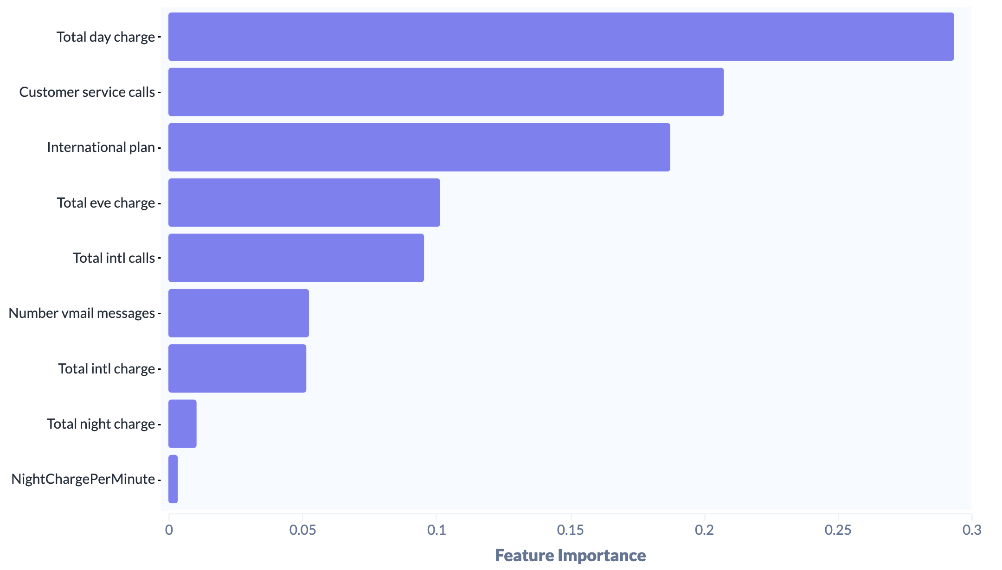
Evaluate Model: Insights
Feature Importance
Your model leveraged these features to drive predictions. Note, different model types might leverage different features

